Slide 1
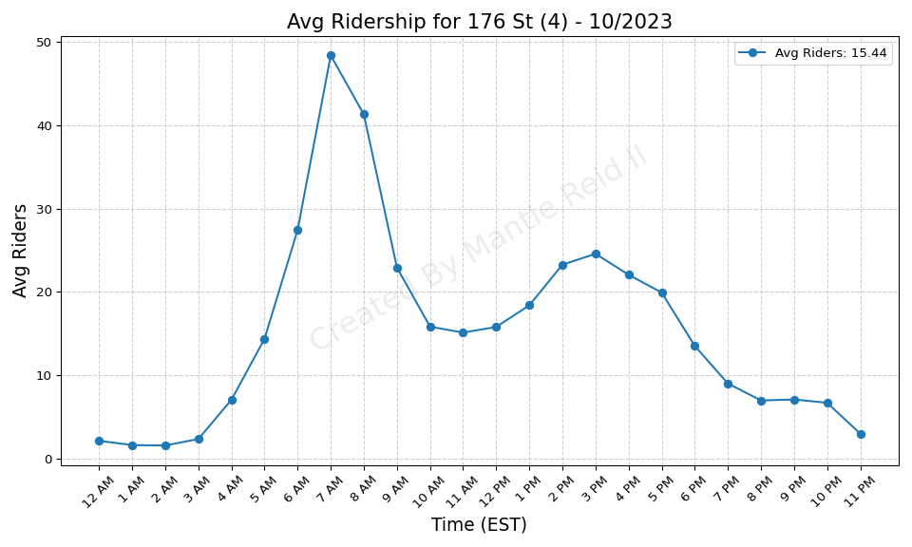
176 St (4) - 10/2023

Slide 2
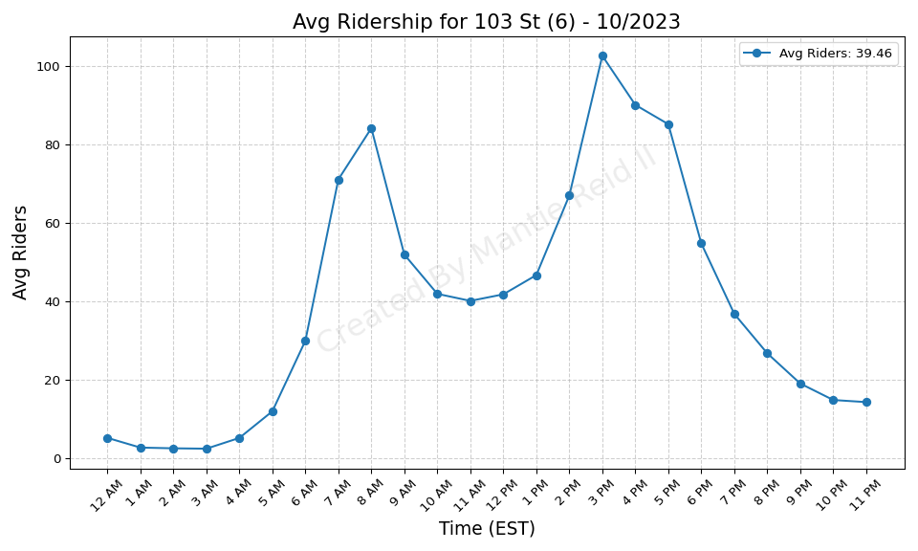
103 St (6) - 10/2023

Slide 3
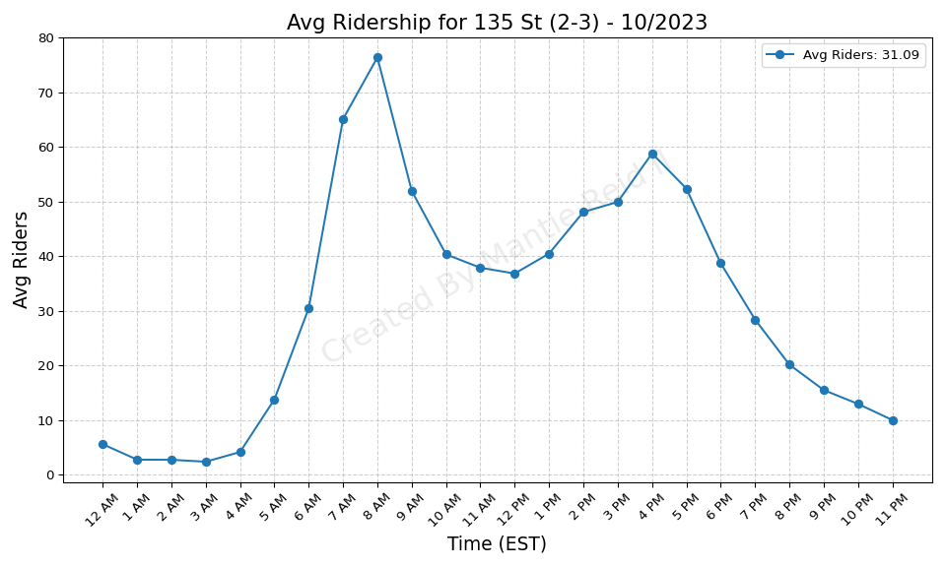
135 St (2-3) - 10/2023

Slide 4
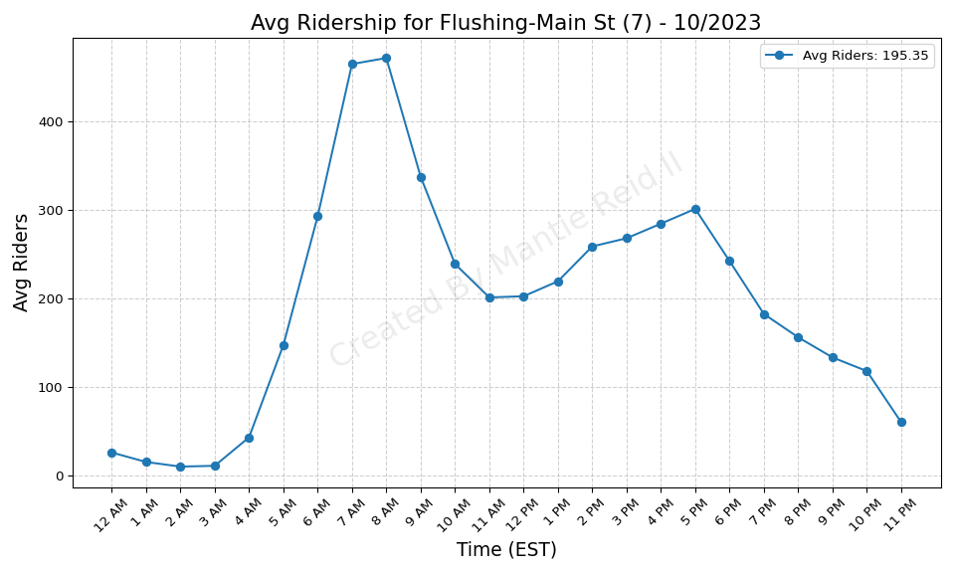
Flushing-Main St (7) - 10/2023

Slide 5
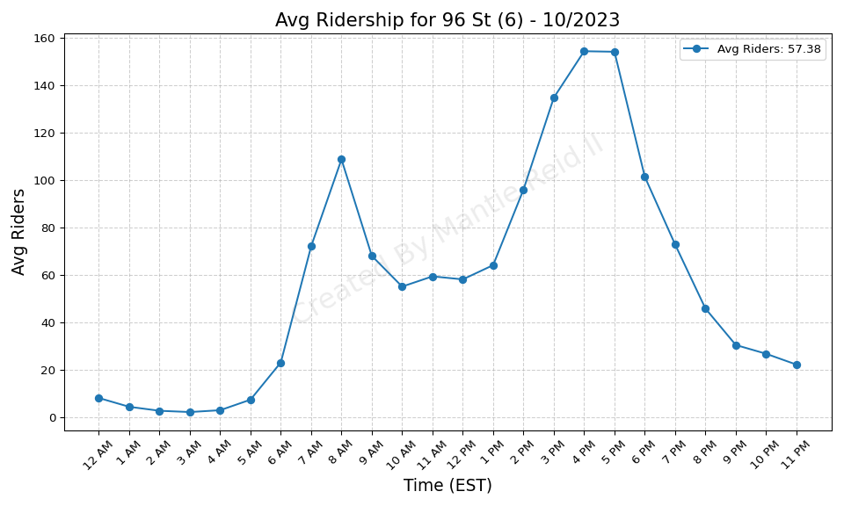
96 St (6) - 10/2023

Slide 6
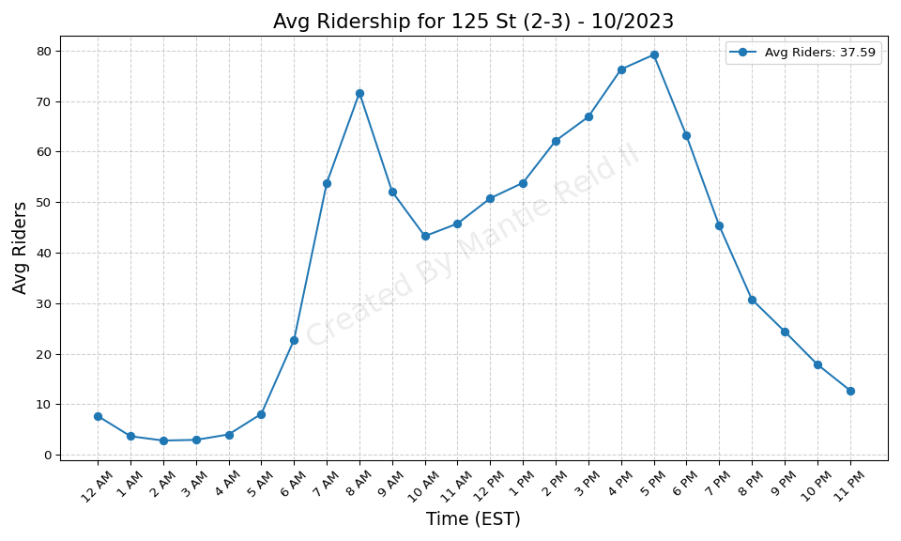
125 St (2-3) - 10/2023

Slide 7
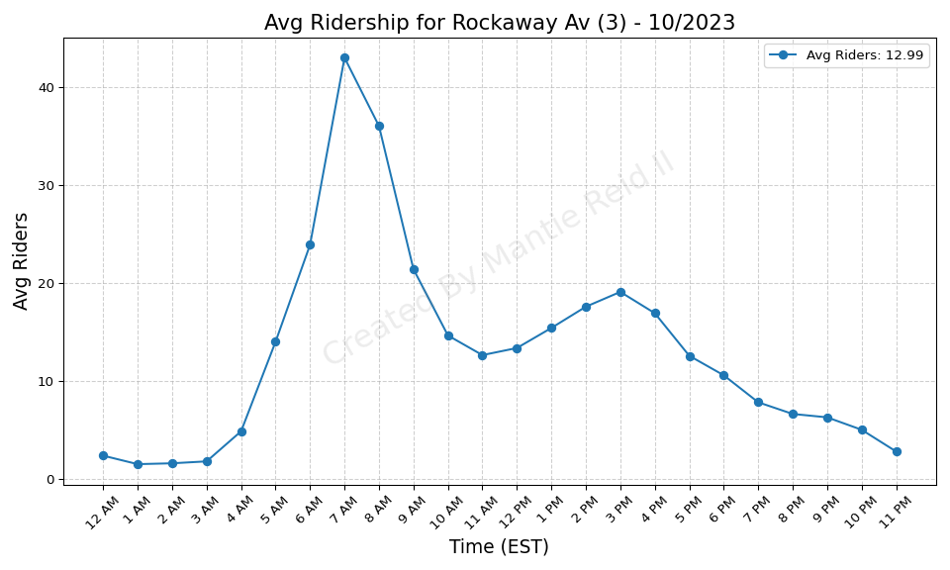
Rockaway Av (3) - 10/2023

Slide 8
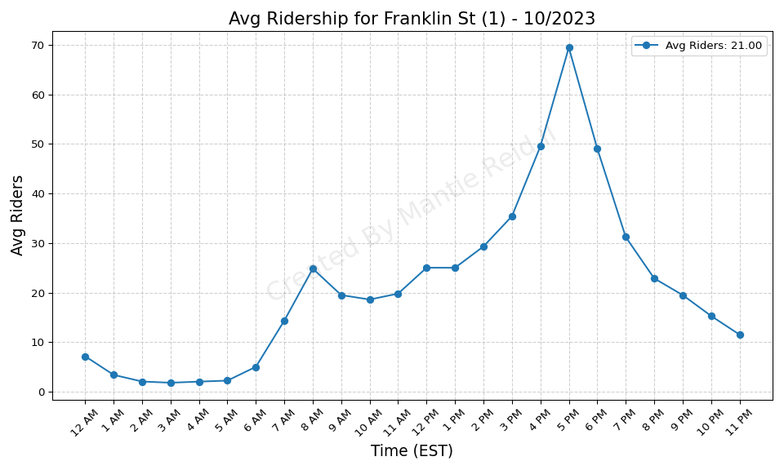
Franklin St (1) - 10/2023

Slide 9
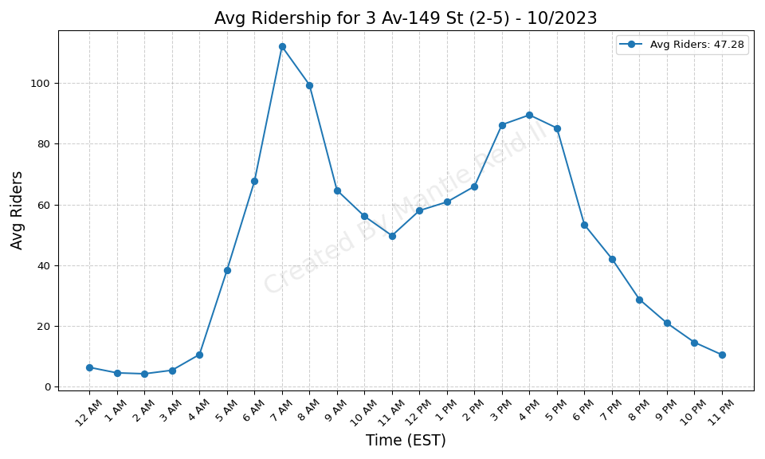
3 Av-149 St (2-5) - 10/2023

Slide 10
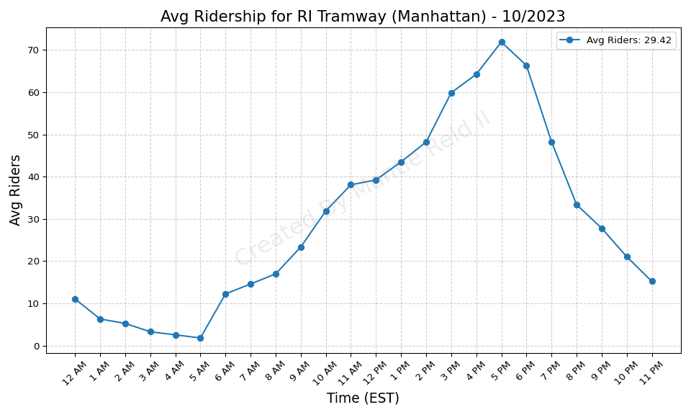
RI Tramway (Manhattan) - 10/2023

Slide 11
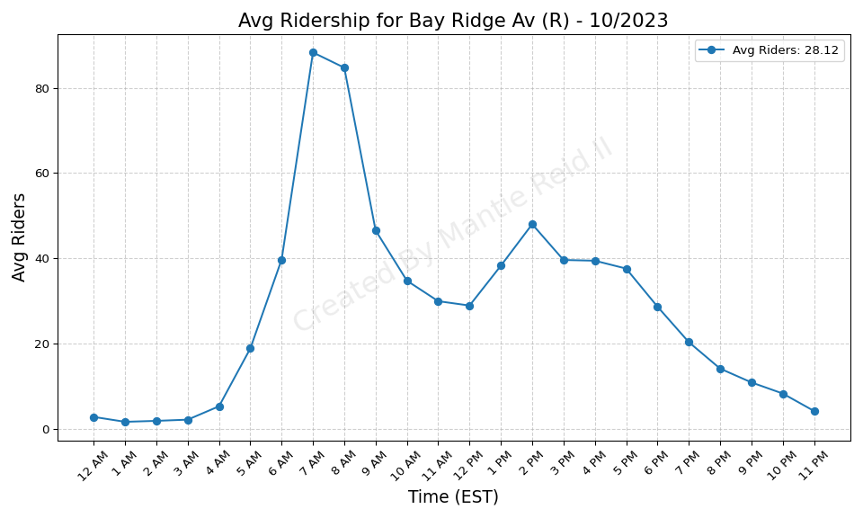
Bay Ridge Av (R) - 10/2023

Slide 12
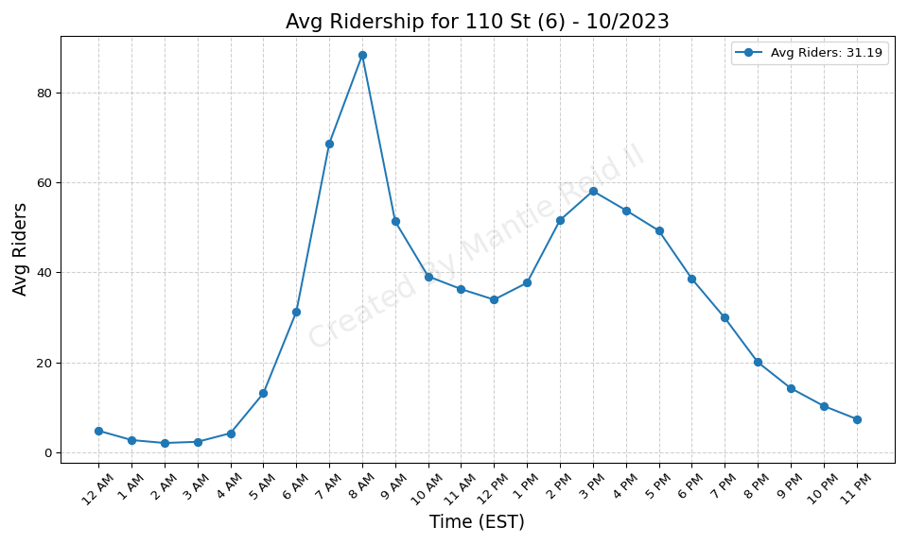
110 St (6) - 10/2023

Slide 13
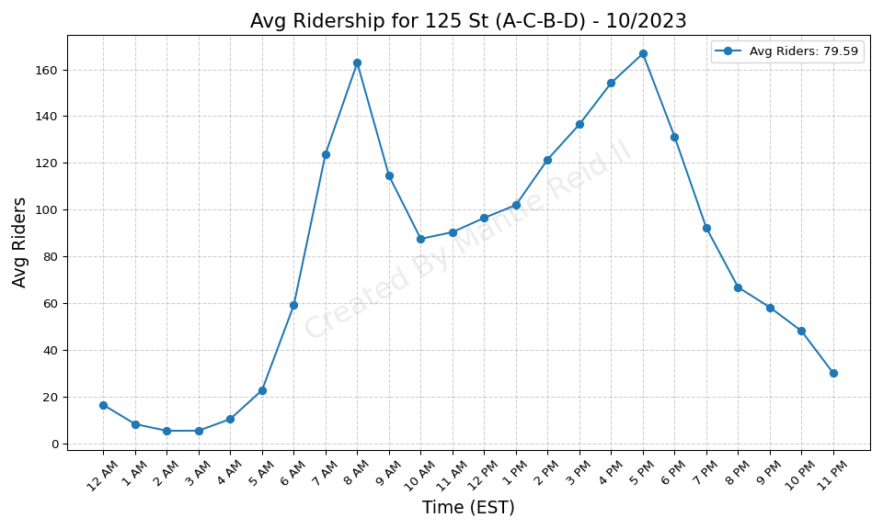
125 St (A-C-B-D) - 10/2023

Slide 14
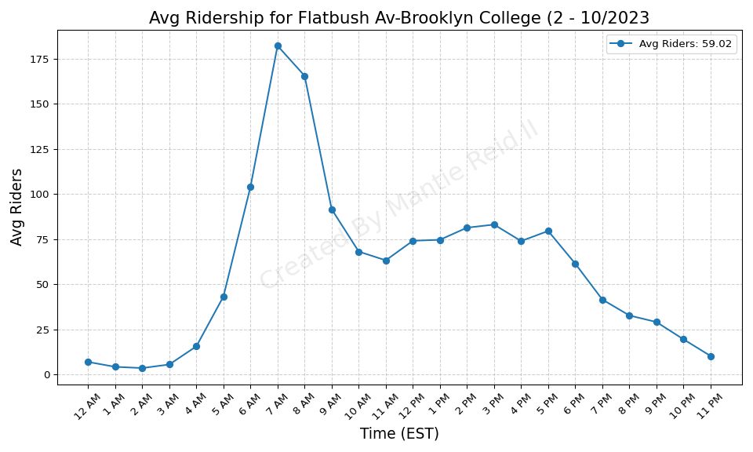
Flatbush Av-Brooklyn College (2 - 10/2023

Slide 15
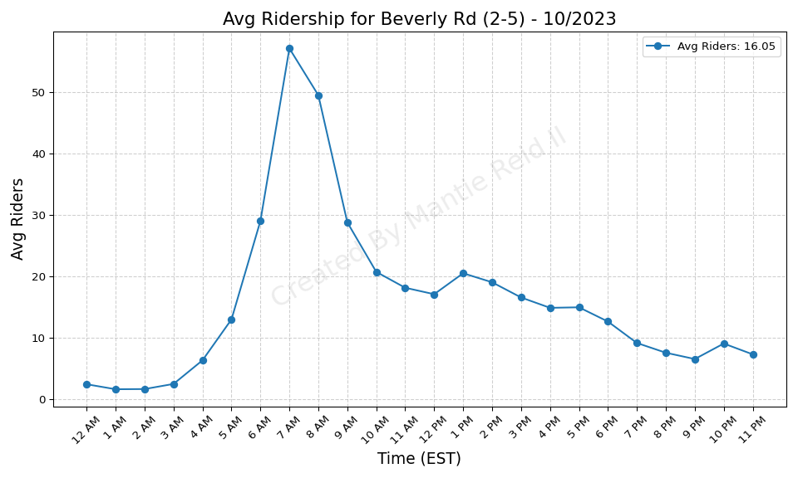
Beverly Rd (2-5) - 10/2023

Slide 16
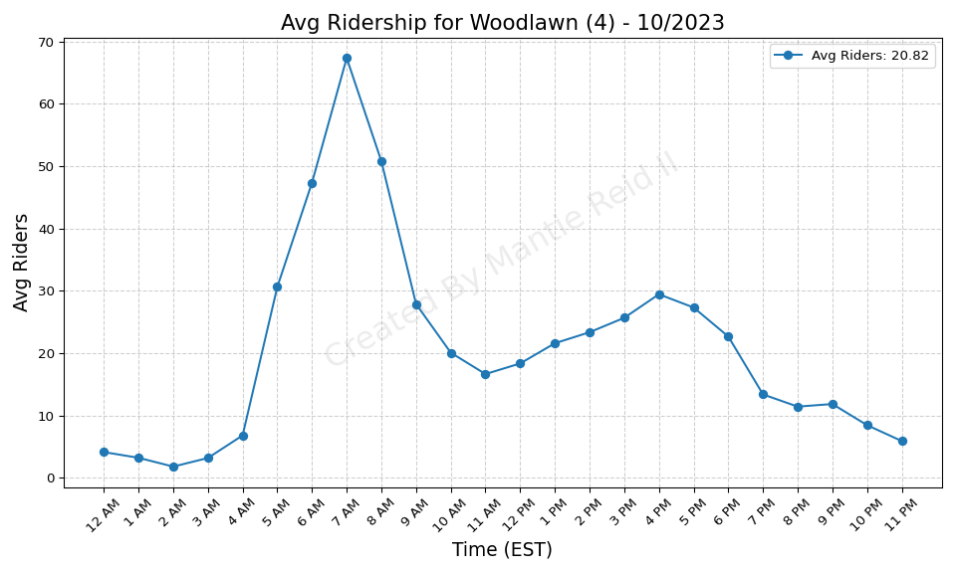
Woodlawn (4) - 10/2023

Slide 17
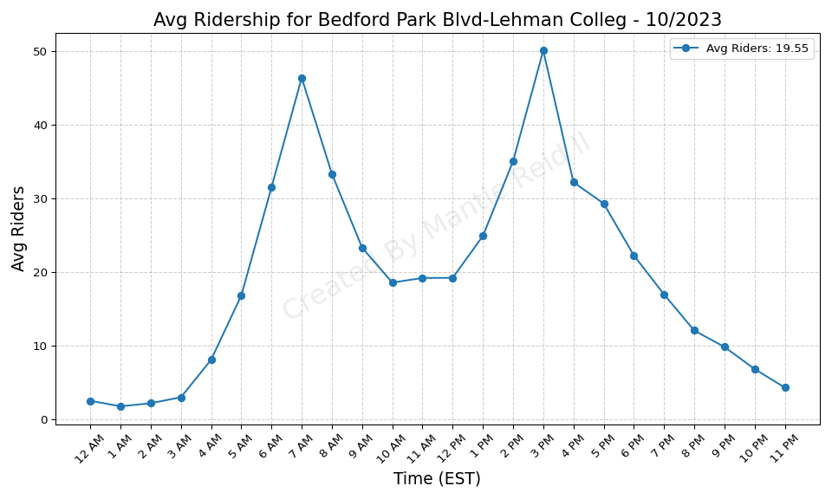
Bedford Park Blvd-Lehman Colleg - 10/2023

Slide 18
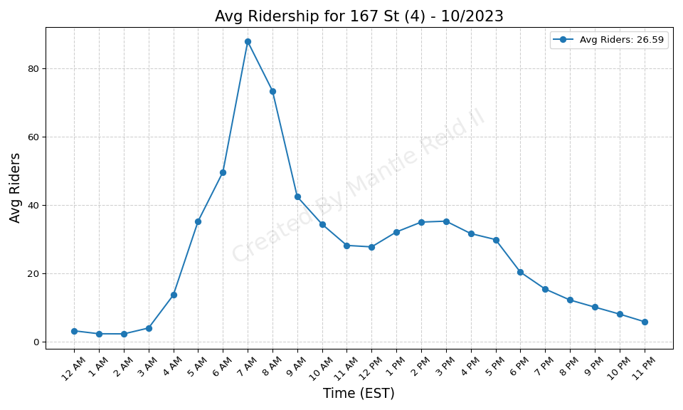
167 St (4) - 10/2023

Slide 19
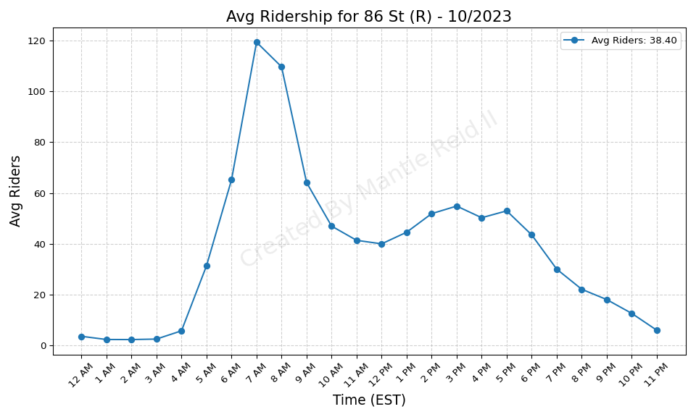
86 St (R) - 10/2023

Slide 20
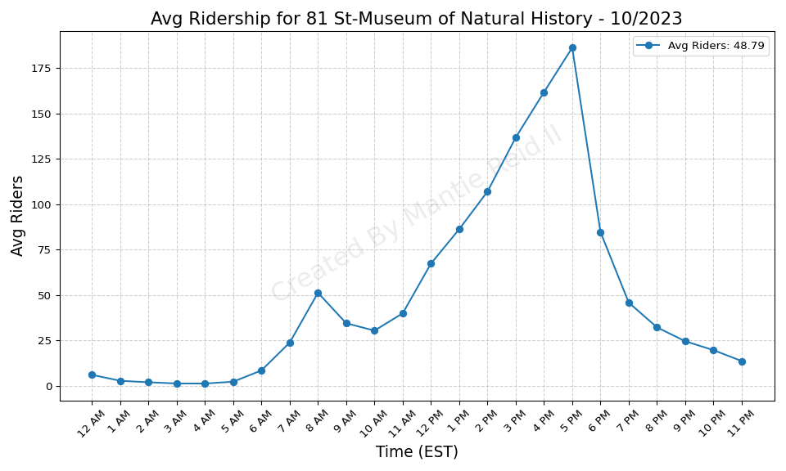
81 St-Museum of Natural History - 10/2023

Slide 21

Van Siclen Av (3) - 10/2023

Slide 22
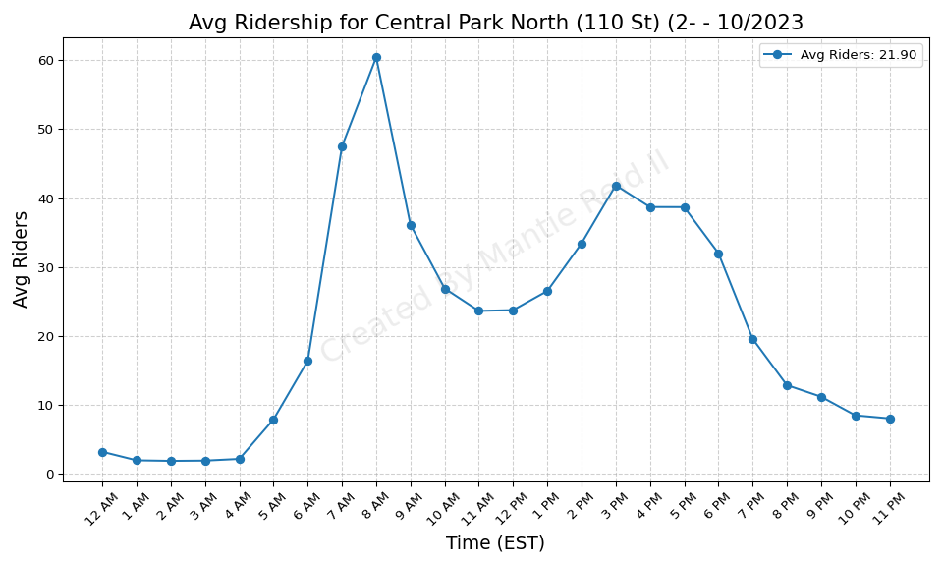
Central Park North (110 St) (2- - 10/2023

Slide 23
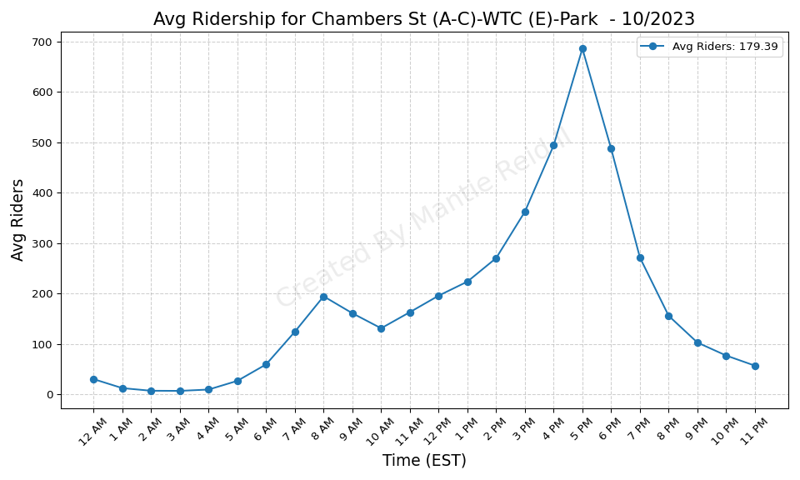
Chambers St (A-C)-WTC (E)-Park - 10/2023

Slide 24
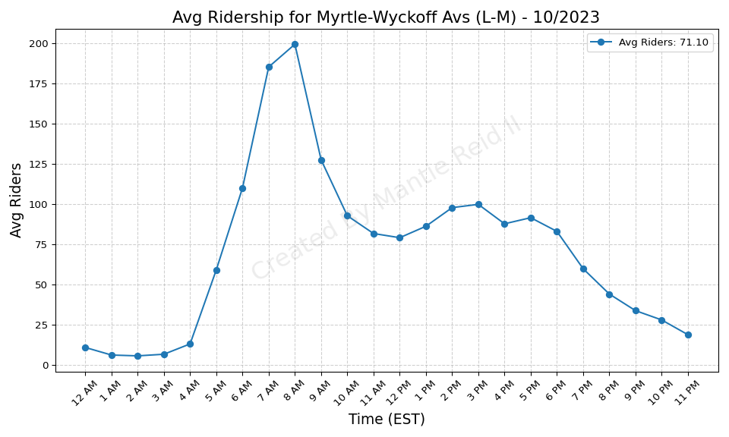
Myrtle-Wyckoff Avs (L-M) - 10/2023

Slide 25
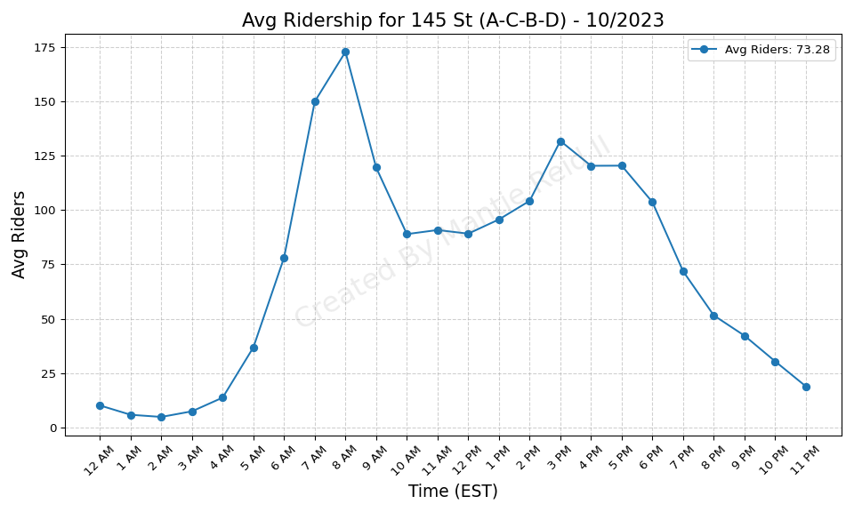
145 St (A-C-B-D) - 10/2023

Slide 26
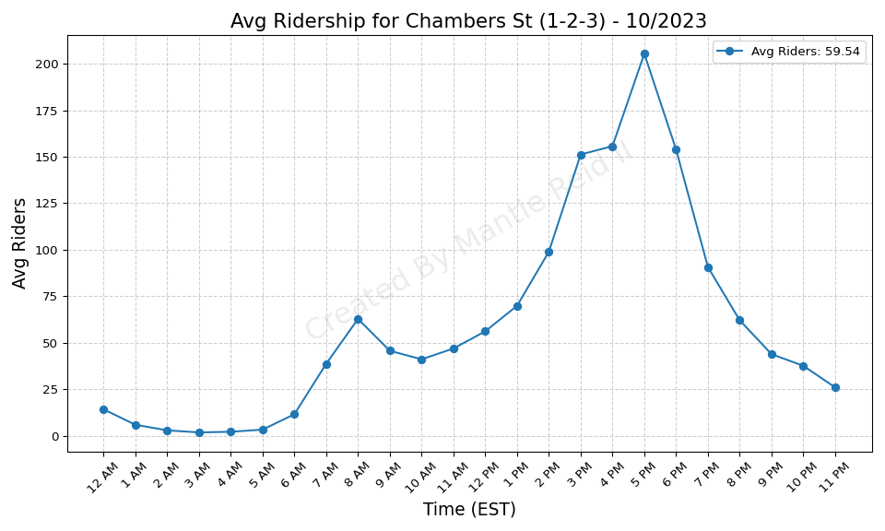
Chambers St (1-2-3) - 10/2023

Slide 27
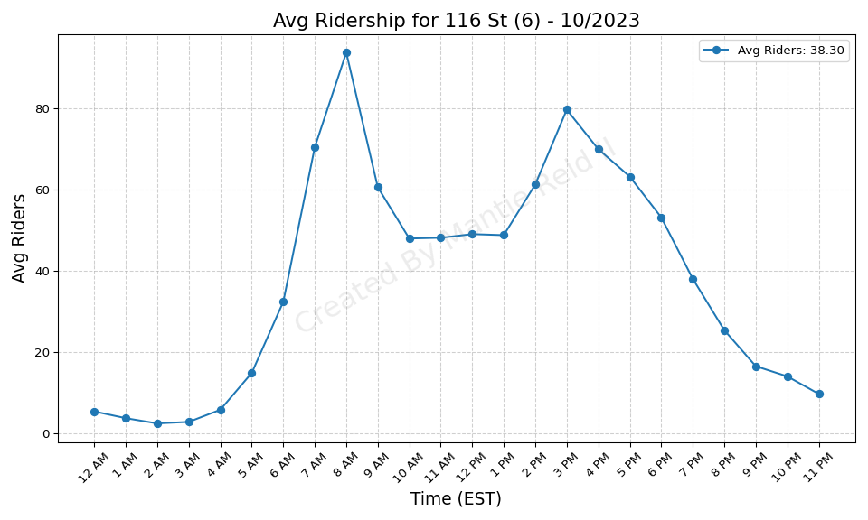
116 St (6) - 10/2023

Slide 28
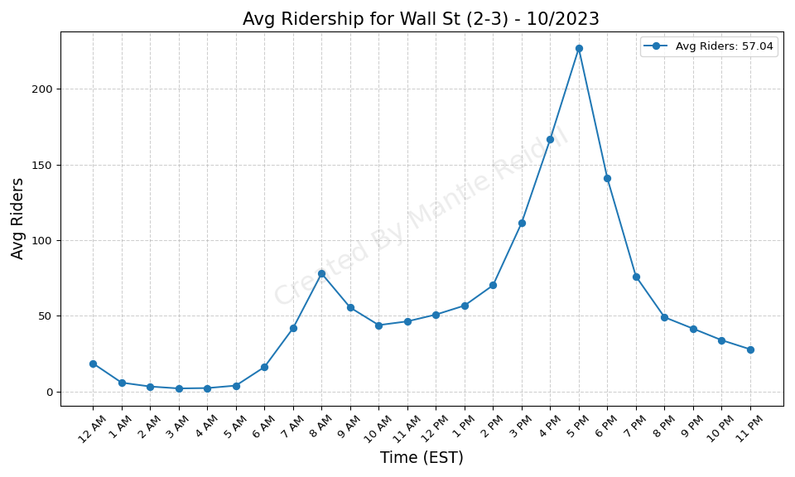
Wall St (2-3) - 10/2023

Slide 29

71 St (D) - 10/2023

Slide 30
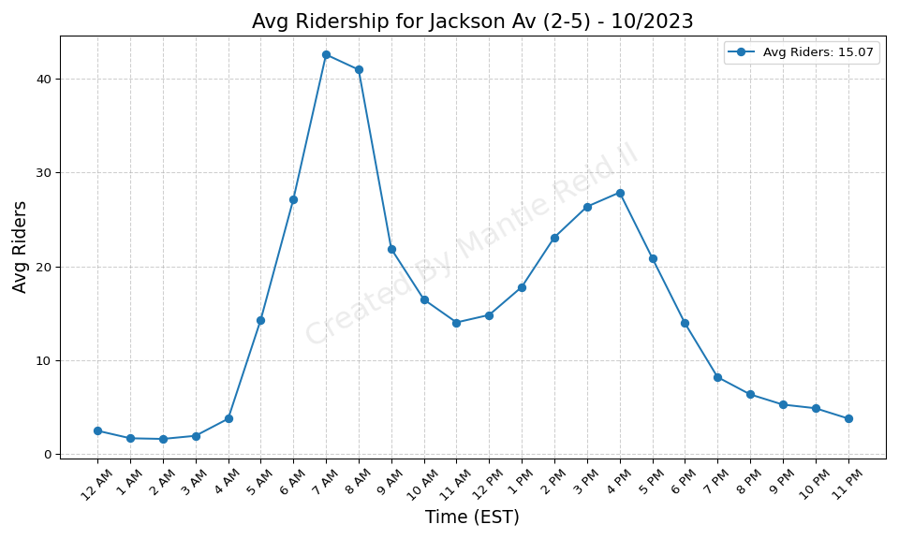
Jackson Av (2-5) - 10/2023

Slide 31
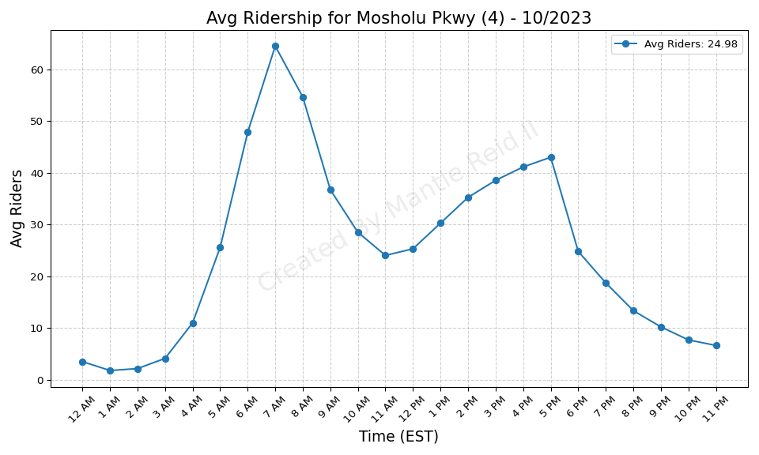
Mosholu Pkwy (4) - 10/2023

Slide 32
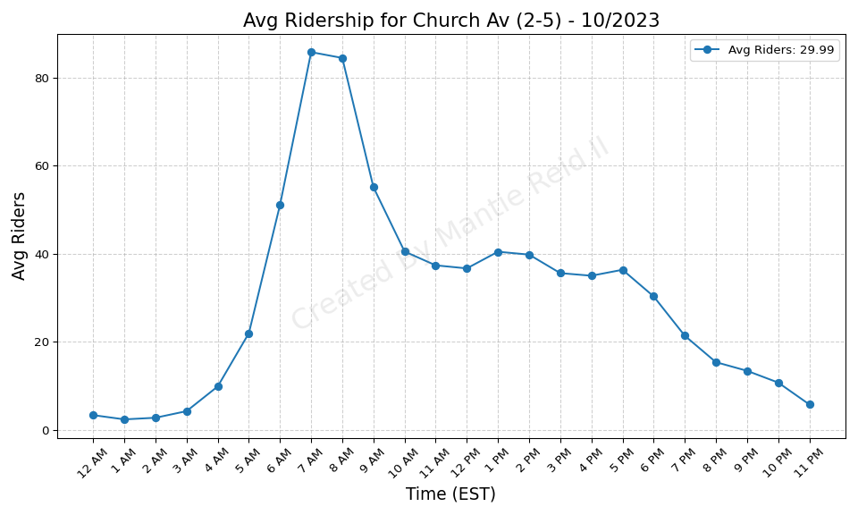
Church Av (2-5) - 10/2023

Slide 33
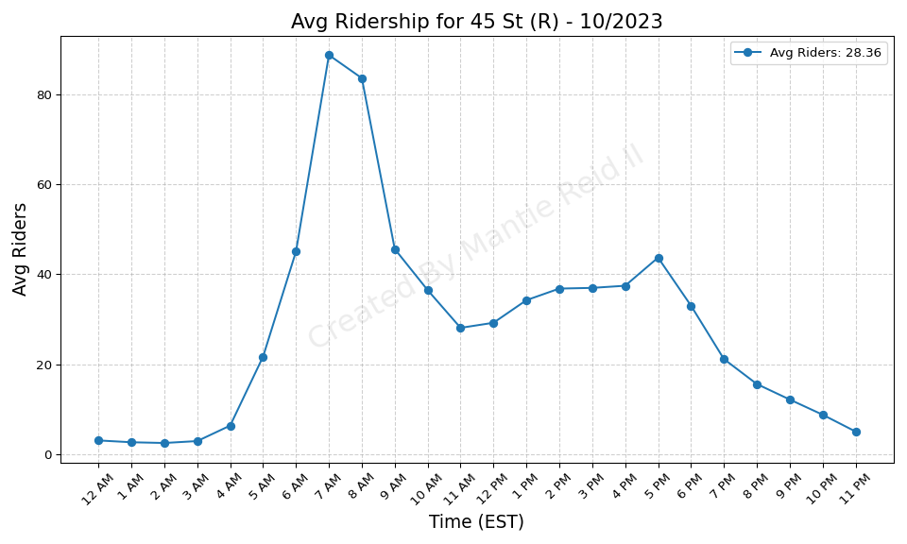
45 St (R) - 10/2023

Slide 34
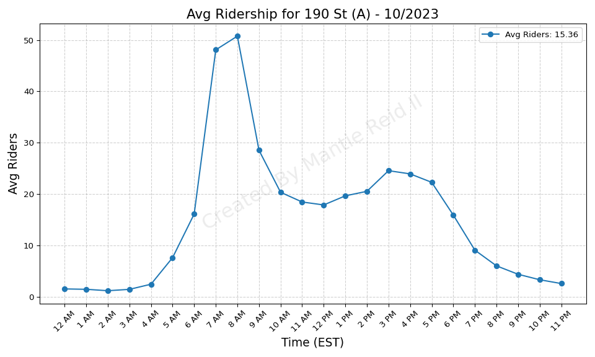
190 St (A) - 10/2023

Slide 35
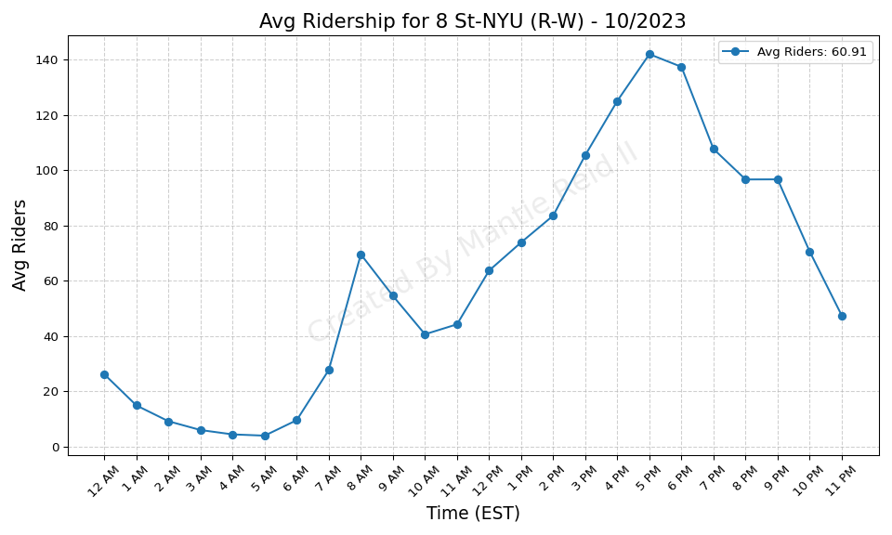
8 St-NYU (R-W) - 10/2023

Slide 36
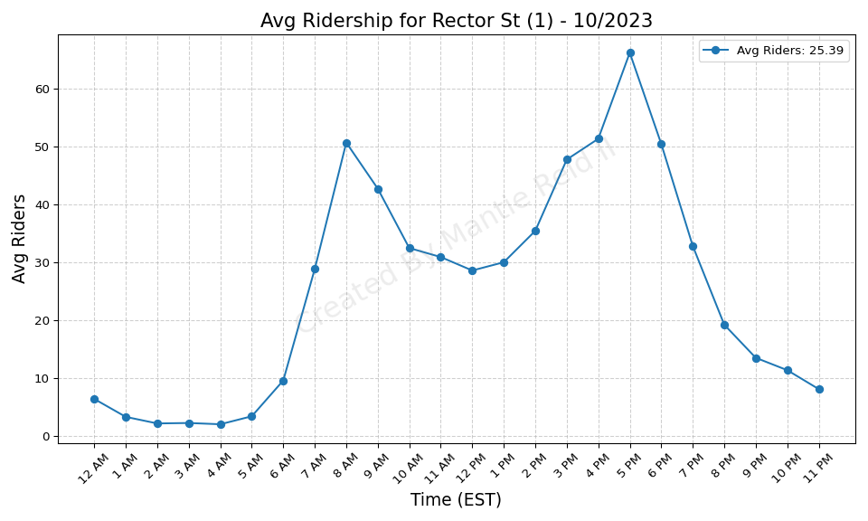
Rector St (1) - 10/2023

Slide 37
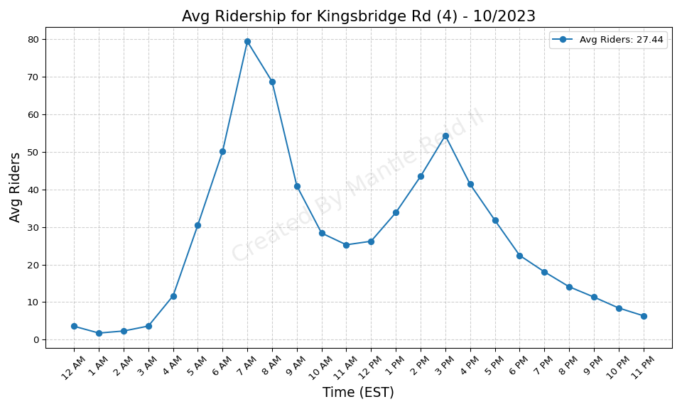
Kingsbridge Rd (4) - 10/2023

Slide 38
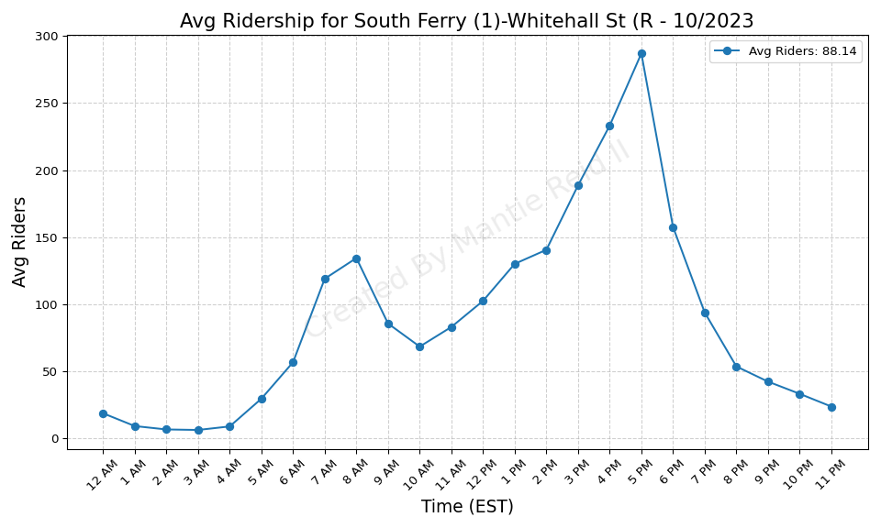
South Ferry (1)-Whitehall St (R - 10/2023

Slide 39
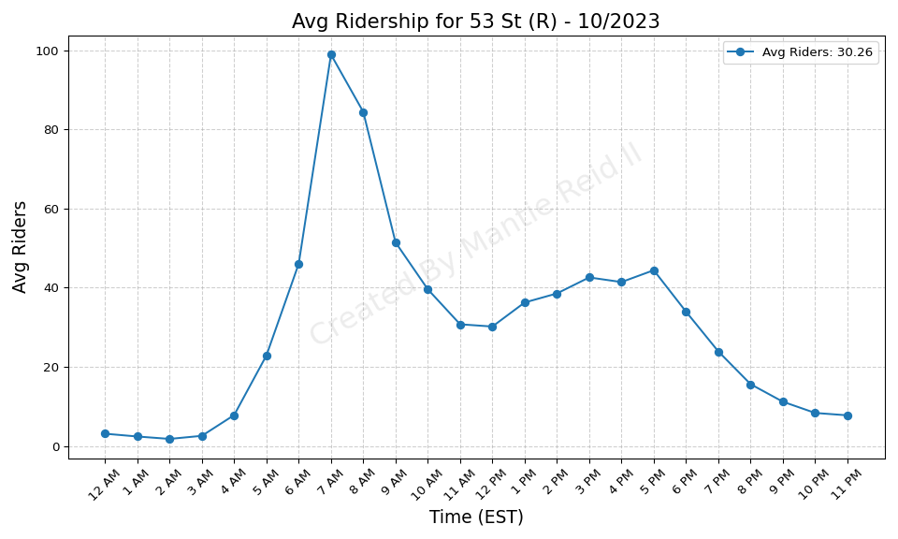
53 St (R) - 10/2023

Slide 40
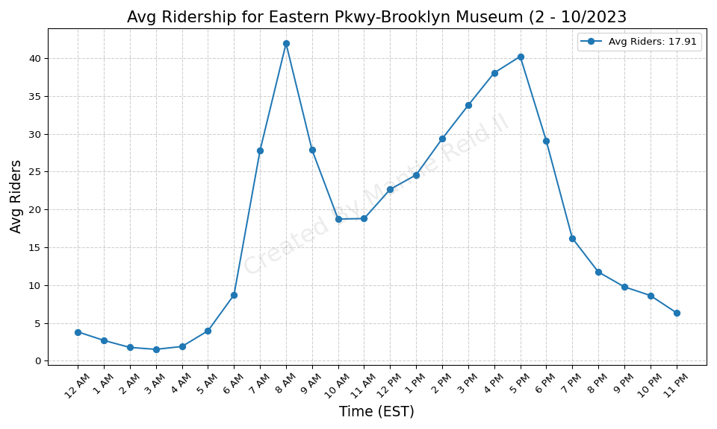
Eastern Pkwy-Brooklyn Museum (2 - 10/2023

Slide 41
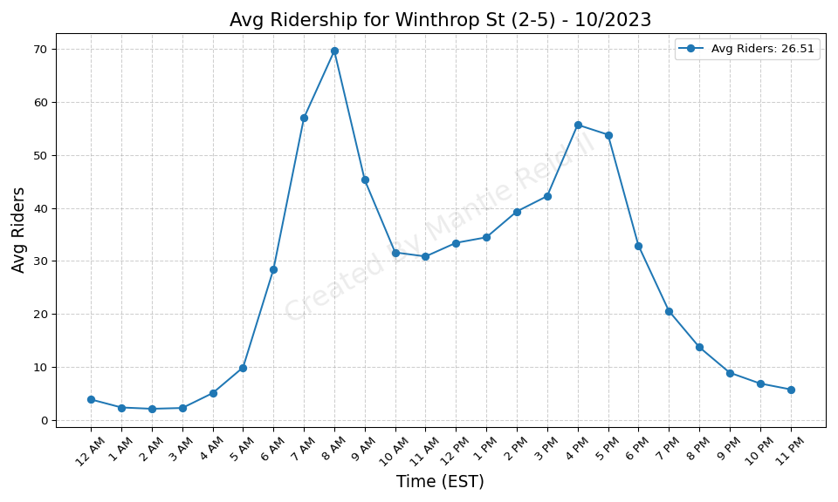
Winthrop St (2-5) - 10/2023

Slide 42
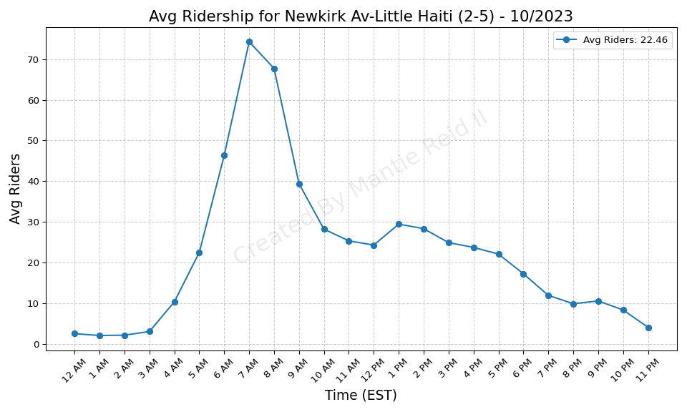
Newkirk Av-Little Haiti (2-5) - 10/2023

Slide 43
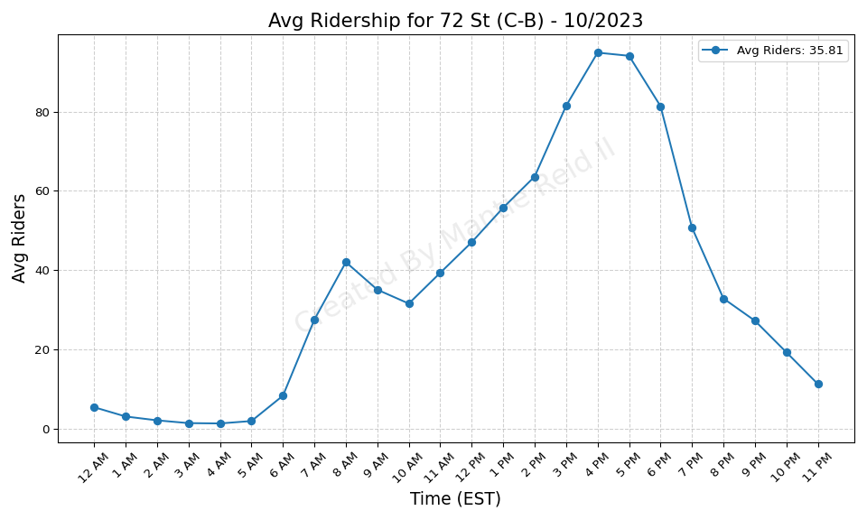
72 St (C-B) - 10/2023

Slide 44
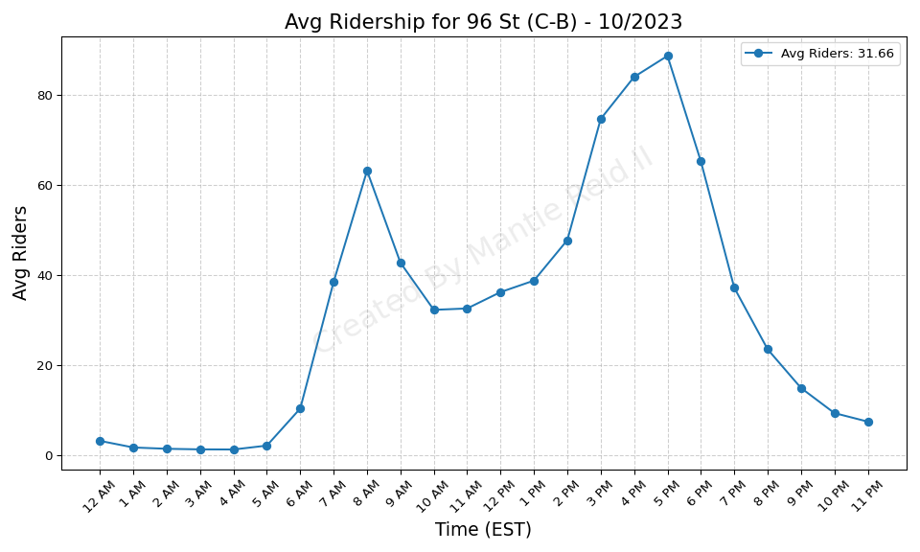
96 St (C-B) - 10/2023

Slide 45
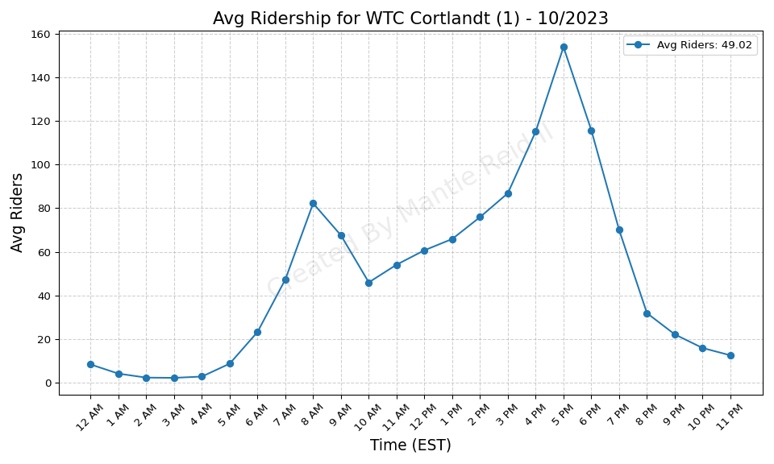
WTC Cortlandt (1) - 10/2023

Slide 46
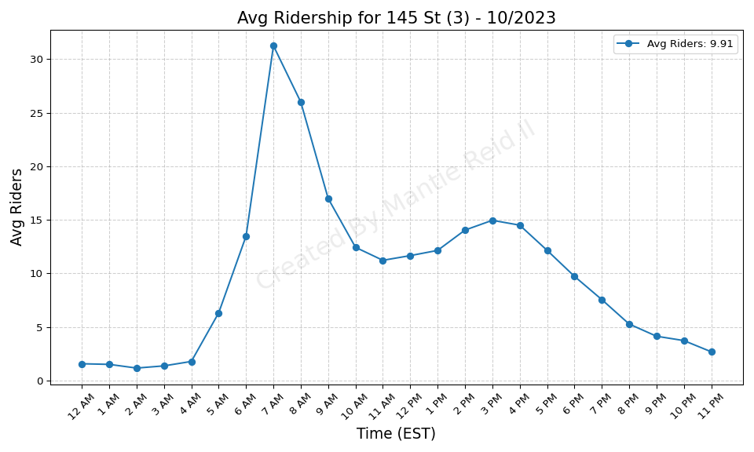
145 St (3) - 10/2023

Slide 47
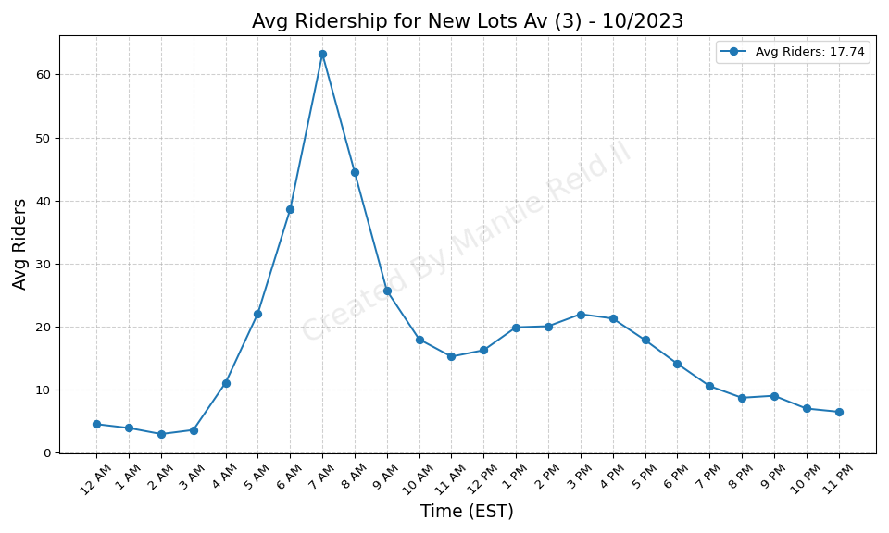
New Lots Av (3) - 10/2023

Slide 48
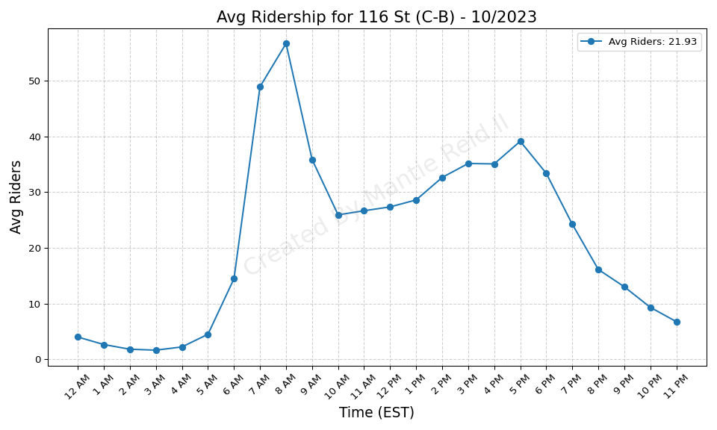
116 St (C-B) - 10/2023

Slide 49
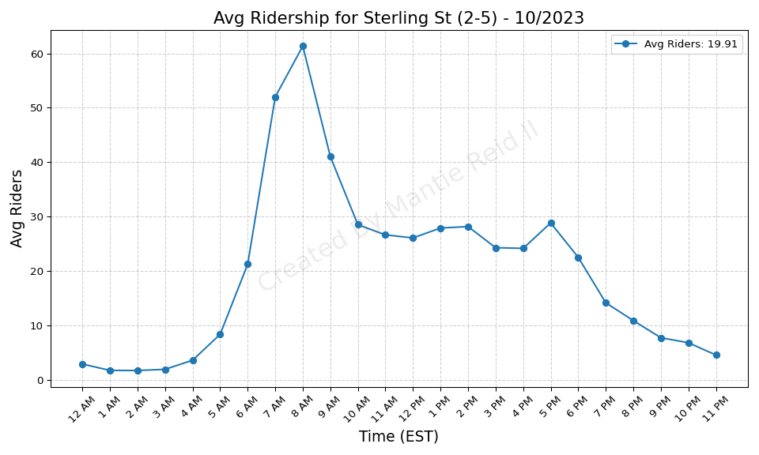
Sterling St (2-5) - 10/2023

Slide 50
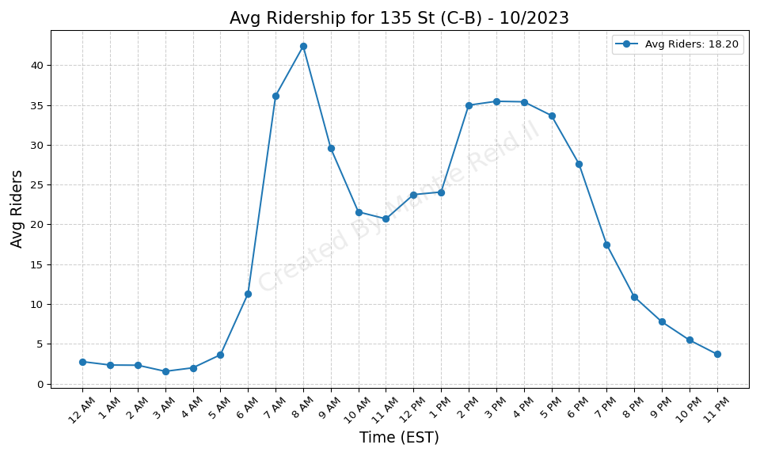
135 St (C-B) - 10/2023

Slide 51
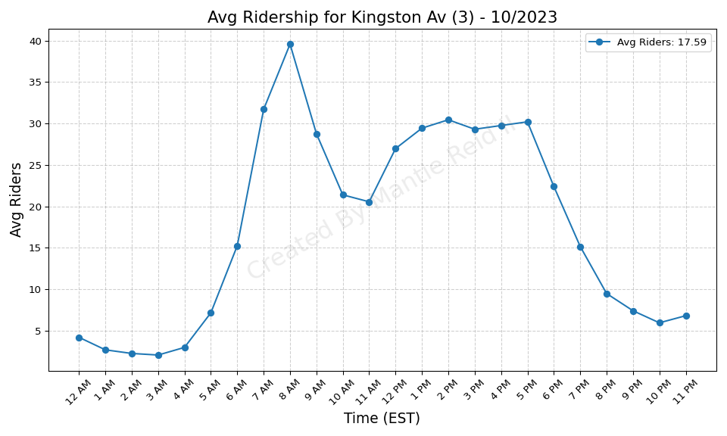
Kingston Av (3) - 10/2023

Slide 52
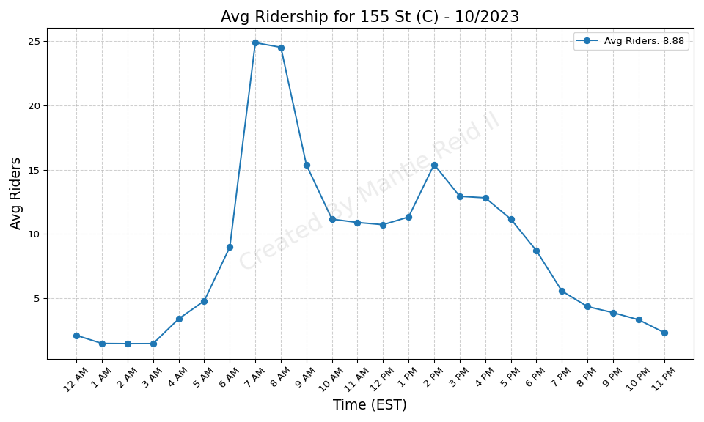
155 St (C) - 10/2023

Slide 53

125 St (4-5-6) - 10/2023

Slide 54

Nostrand Av (3) - 10/2023

Slide 55

Grand Army Plaza (2-3) - 10/2023

Slide 56

Brooklyn Bridge-City Hall (4-5- - 10/2023

Slide 57

Pelham Pkwy (5) - 10/2023

Slide 58

Jay St-MetroTech (A-C-F-R) - 10/2023

Slide 59

RI Tramway (Roosevelt) - 10/2023

Slide 60

Pelham Bay Park (6) - 10/2023

Slide 61

Pennsylvania Av (3) - 10/2023

Slide 62

Bay Ridge-95 St (R) - 10/2023

Slide 63

183 St (4) - 10/2023

Slide 64

50 St (C-E) - 10/2023

Slide 65

Intervale Av (2-5) - 10/2023

Slide 66

Cathedral Pkwy (110 St) (C-B) - 10/2023

Slide 67

Saratoga Av (3) - 10/2023

Slide 68

Gun Hill Rd (5) - 10/2023

Slide 69

Mt Eden Av (4) - 10/2023

Slide 70

Junius St (3) - 10/2023

Slide 71

181 St (A) - 10/2023

Slide 72

Fordham Rd (4) - 10/2023

Slide 73

Prospect Av (2-5) - 10/2023

Slide 74

Delancey St (F)-Essex St (J-M-Z - 10/2023

Slide 75

86 St (4-5-6) - 10/2023

Slide 76

Eastchester-Dyre Av (5) - 10/2023

Slide 77

Fulton St (A-C-J-Z-2-3-4-5) - 10/2023

Slide 78

Sutter Av-Rutland Rd (3) - 10/2023

Slide 79

Burnside Av (4) - 10/2023

Slide 80

Franklin Av (C-S) - 10/2023

Slide 81

Baychester Av (5) - 10/2023

Slide 82

Lorimer St (M-J) - 10/2023

Slide 83

116 St (2-3) - 10/2023

Slide 84

163 St-Amsterdam Av (C) - 10/2023

Slide 85

President St-Medgar Evers Colle - 10/2023

Slide 86

Hoyt St (2-3) - 10/2023

Slide 87

Morris Park (5) - 10/2023

Slide 88

79 St (D) - 10/2023

Slide 89

Broadway Junction (A-C-J-L-Z) - 10/2023

Slide 90

138 St-Grand Concourse (4-5) - 10/2023

Slide 91

Court St (R)-Borough Hall (2-3- - 10/2023

Slide 92

59 St (N-R) - 10/2023

Slide 93

Church Av (B-Q) - 10/2023

Slide 94

Bergen St (2-3) - 10/2023

Slide 95

Crown Hts-Utica Av (3-4) - 10/2023

Slide 96

86 St (C-B) - 10/2023

Slide 97

Franklin Av (2-3-4-5)-Botanic G - 10/2023

Slide 98

Nevins St (2-3-4-5) - 10/2023

Slide 99

103 St (C-B) - 10/2023

Slide 100

Clark St (2-3) - 10/2023

Slide 101

175 St (A) - 10/2023

Slide 102

170 St (4) - 10/2023

Slide 103

Harlem-148 St (3) - 10/2023

Slide 104

Lorimer St (L)-Metropolitan Av - 10/2023

Slide 105

Canal St (J-N-Q-R-W-Z-6) - 10/2023

Slide 106

3 Av-138 St (6) - 10/2023

Slide 107

Mets-Willets Point (7) - 10/2023

Slide 108

Buhre Av (6) - 10/2023

Slide 109

Fordham Rd (B-D) - 10/2023

Slide 110

Spring St (6) - 10/2023

Slide 111

Beach 25 St (A) - 10/2023

Slide 112

52 St (7) - 10/2023

Slide 113

86 St (1) - 10/2023

Slide 114

111 St (J) - 10/2023

Slide 115

Astor Pl (6) - 10/2023

Slide 116

Crescent St (J-Z) - 10/2023

Slide 117

Wakefield-241 St (2) - 10/2023

Slide 118

75 Av (E-F) - 10/2023

Slide 119

33 St (6) - 10/2023

Slide 120

75 St-Elderts Ln (J-Z) - 10/2023

Slide 121

25 St (R) - 10/2023

Slide 122

DeKalb Av (L) - 10/2023

Slide 123

36 St (D-N-R) - 10/2023

Slide 124

28 St (6) - 10/2023

Slide 125

Ocean Pkwy (Q) - 10/2023

Slide 126

Flushing Av (M-J) - 10/2023

Slide 127

Kosciuszko St (J) - 10/2023

Slide 128

111 St (7) - 10/2023

Slide 129

Junction Blvd (7) - 10/2023

Slide 130

Cortelyou Rd (Q) - 10/2023

Slide 131

103 St-Corona Plaza (7) - 10/2023

Slide 132

28 St (R-W) - 10/2023

Slide 133

Van Siclen Av (J-Z) - 10/2023

Slide 134

Northern Blvd (M-R) - 10/2023

Slide 135

14 St (F-M-1-2-3)-6 Av (L) - 10/2023

Slide 136

34 St-Herald Sq (B-D-F-M-N-Q-R- - 10/2023

Slide 137

50 St (1) - 10/2023

Slide 138

Kew Gardens-Union Tpke (E-F) - 10/2023

Slide 139

Woodhaven Blvd (J-Z) - 10/2023

Slide 140

Beverley Rd (Q) - 10/2023

Slide 141

7 Av (B-Q) - 10/2023

Slide 142

23 St (6) - 10/2023

Slide 143

Beach 44 St (A) - 10/2023

Slide 144

57 St-7 Av (N-Q-R-W) - 10/2023

Slide 145

Montrose Av (L) - 10/2023

Slide 146

63 Dr-Rego Park (M-R) - 10/2023

Slide 147

Beach 60 St (A) - 10/2023

Slide 148

90 St-Elmhurst Av (7) - 10/2023

Slide 149

Bryant Pk (B-D-F-M)-5 Av (7) - 10/2023

Slide 150

W 8 St-NY Aquarium (F-Q) - 10/2023

Slide 151

Tremont Av (B-D) - 10/2023

Slide 152

Gates Av (J-Z) - 10/2023

Slide 153

Myrtle Av (M-J-Z) - 10/2023

Slide 154

Jefferson St (L) - 10/2023

Slide 155

Christopher St-Sheridan Sq (1) - 10/2023

Slide 156

Beach 67 St (A) - 10/2023

Slide 157

67 Av (M-R) - 10/2023

Slide 158

Alabama Av (J) - 10/2023

Slide 159

Grand Av-Newtown (M-R) - 10/2023

Slide 160

23 St (1) - 10/2023

Slide 161

103 St (1) - 10/2023

Slide 162

Halsey St (J) - 10/2023

Slide 163

28 St (1) - 10/2023

Slide 164

170 St (B-D) - 10/2023

Slide 165

Queensboro Plaza (7-N-W) - 10/2023

Slide 166

34 St-Penn Station (1-2-3) - 10/2023

Slide 167

174-175 Sts (B-D) - 10/2023

Slide 168

Bushwick Av-Aberdeen St (L) - 10/2023

Slide 169

Wall St (4-5) - 10/2023

Slide 170

39 Av-Dutch Kills (N-W) - 10/2023

Slide 171

36 St (M-R) - 10/2023

Slide 172

96 St (1-2-3) - 10/2023

Slide 173

Bowling Green (4-5) - 10/2023

Slide 174

Woodhaven Blvd (M-R) - 10/2023

Slide 175

33 St-Rawson St (7) - 10/2023

Slide 176

Queens Plaza (E-M-R) - 10/2023

Slide 177

69 St (7) - 10/2023

Slide 178

Broadway (N-W) - 10/2023

Slide 179

Houston St (1) - 10/2023

Slide 180

18 St (1) - 10/2023

Slide 181

155 St (B-D) - 10/2023

Slide 182

Steinway St (M-R) - 10/2023

Slide 183

46 St-Bliss St (7) - 10/2023

Slide 184

Morgan Av (L) - 10/2023

Slide 185

Halsey St (L) - 10/2023

Slide 186

79 St (1) - 10/2023

Slide 187

182-183 Sts (B-D) - 10/2023

Slide 188

82 St-Jackson Hts (7) - 10/2023

Slide 189

4 Av (F-G)-9 St (R) - 10/2023

Slide 190

DeKalb Av (B-Q-R) - 10/2023

Slide 191

14 St-Union Sq (L-N-Q-R-W-4-5-6 - 10/2023

Slide 192

Wilson Av (L) - 10/2023

Slide 193

68 St-Hunter College (6) - 10/2023

Slide 194

46 St (M-R) - 10/2023

Slide 195

168 St (A-C-1) - 10/2023

Slide 196

167 St (B-D) - 10/2023

Slide 197

77 St (6) - 10/2023

Slide 198

Court Sq (E-G-M-7) - 10/2023

Slide 199

61 St-Woodside (7) - 10/2023

Slide 200

Beach 36 St (A) - 10/2023

Slide 201

85 St-Forest Pkwy (J) - 10/2023

Slide 202

Rockaway Park-Beach 116 St (A-S - 10/2023

Slide 203

Hunters Point Av (7) - 10/2023

Slide 204

65 St (M-R) - 10/2023

Slide 205

66 St-Lincoln Center (1) - 10/2023

Slide 206

Chauncey St (J-Z) - 10/2023

Slide 207

Norwood-205 St (D) - 10/2023

Slide 208

Elmhurst Av (M-R) - 10/2023

Slide 209

Rector St (R-W) - 10/2023

Slide 210

Vernon Blvd-Jackson Av (7) - 10/2023

Slide 211

9 Av (D) - 10/2023

Slide 212

Cleveland St (J) - 10/2023

Slide 213

Forest Hills-71 Av (E-F-M-R) - 10/2023

Slide 214

Kingsbridge Rd (B-D) - 10/2023

Slide 215

Coney Island-Stillwell Av (D-F- - 10/2023

Slide 216

Beach 105 St (A-S) - 10/2023

Slide 217

161 St-Yankee Stadium (B-D-4) - 10/2023

Slide 218

149 St-Grand Concourse (2-4-5) - 10/2023

Slide 219

Canal St (1) - 10/2023

Slide 220

Fort Hamilton Pkwy (D) - 10/2023

Slide 221

Norwood Av (J-Z) - 10/2023

Slide 222

Far Rockaway-Mott Av (A) - 10/2023

Slide 223

Atlantic Av (L) - 10/2023

Slide 224

72 St (1-2-3) - 10/2023

Slide 225

Bedford Park Blvd (B-D) - 10/2023

Slide 226

Cypress Hills (J) - 10/2023

Slide 227

40 St-Lowery St (7) - 10/2023

Slide 228

104 St (J-Z) - 10/2023

Slide 229

Briarwood (E-F) - 10/2023

Slide 230

21 St-Queensbridge (F) - 10/2023

Slide 231

Bay Pkwy (F) - 10/2023

Slide 232

125 St (1) - 10/2023

Slide 233

23 St (C-E) - 10/2023

Slide 234

104 St (A) - 10/2023

Slide 235

169 St (F) - 10/2023

Slide 236

Avenue P (F) - 10/2023

Slide 237

30 Av (N-W) - 10/2023

Slide 238

Central Av (M) - 10/2023

Slide 239

80 St (A) - 10/2023

Slide 240

18 Av (F) - 10/2023

Slide 241

88 St (A) - 10/2023

Slide 242

Whitlock Av (6) - 10/2023

Slide 243

Grand St (L) - 10/2023

Slide 244

Park Pl (S) - 10/2023

Slide 245

Avenue N (F) - 10/2023

Slide 246

York St (F) - 10/2023

Slide 247

Graham Av (L) - 10/2023

Slide 248

Brook Av (6) - 10/2023

Slide 249

Sutphin Blvd (F) - 10/2023

Slide 250

Grant Av (A) - 10/2023

Slide 251

57 St (F) - 10/2023

Slide 252

Zerega Av (6) - 10/2023

Slide 253

Morrison Av-Soundview (6) - 10/2023

Slide 254

Marcy Av (M-J-Z) - 10/2023

Slide 255

East 105 St (L) - 10/2023

Slide 256

Parkchester (6) - 10/2023

Slide 257

Marble Hill-225 St (1) - 10/2023

Slide 258

23 St (F-M) - 10/2023

Slide 259

137 St-City College (1) - 10/2023

Slide 260

Canarsie-Rockaway Pkwy (L) - 10/2023

Slide 261

W 4 St-Wash Sq (A-C-E-B-D-F-M) - 10/2023

Slide 262

231 St (1) - 10/2023

Slide 263

Rockaway Blvd (A) - 10/2023

Slide 264

Beach 98 St (A-S) - 10/2023

Slide 265

Roosevelt Island (F) - 10/2023

Slide 266

2 Av (F) - 10/2023

Slide 267

Hunts Point Av (6) - 10/2023

Slide 268

Parsons Blvd (F) - 10/2023

Slide 269

Lafayette Av (C) - 10/2023

Slide 270

Ralph Av (C) - 10/2023

Slide 271

181 St (1) - 10/2023

Slide 272

Ditmas Av (F) - 10/2023

Slide 273

Forest Av (M) - 10/2023

Slide 274

Inwood-207 St (A) - 10/2023

Slide 275

Astoria-Ditmars Blvd (N-W) - 10/2023

Slide 276

23 St (R-W) - 10/2023

Slide 277

Middle Village-Metropolitan Av - 10/2023

Slide 278

Beach 90 St (A-S) - 10/2023

Slide 279

207 St (1) - 10/2023

Slide 280

Lexington Av-63 St (F-Q) - 10/2023

Slide 281

Avenue U (F) - 10/2023

Slide 282

Broad St (J-Z) - 10/2023

Slide 283

111 St (A) - 10/2023

Slide 284

Middletown Rd (6) - 10/2023

Slide 285

1 Av (L) - 10/2023

Slide 286

Cypress Av (6) - 10/2023

Slide 287

Dyckman St (A) - 10/2023

Slide 288

238 St (1) - 10/2023

Slide 289

Cathedral Pkwy (110 St) (1) - 10/2023

Slide 290

Bowery (J-Z) - 10/2023

Slide 291

Kings Hwy (F) - 10/2023

Slide 292

Longwood Av (6) - 10/2023

Slide 293

Neptune Av (F) - 10/2023

Slide 294

E 143 St-St Mary-s St (6) - 10/2023

Slide 295

145 St (1) - 10/2023

Slide 296

191 St (1) - 10/2023

Slide 297

Church Av (F-G) - 10/2023

Slide 298

157 St (1) - 10/2023

Slide 299

Rockaway Av (C) - 10/2023

Slide 300

East Broadway (F) - 10/2023

Slide 301

49 St (N-R-W) - 10/2023

Slide 302

Prince St (R-W) - 10/2023

Slide 303

St Lawrence Av (6) - 10/2023

Slide 304

Hewes St (M-J) - 10/2023

Slide 305

Broad Channel (A-S) - 10/2023

Slide 306

Westchester Sq-E Tremont Av (6) - 10/2023

Slide 307

Avenue X (F) - 10/2023

Slide 308

Aqueduct Racetrack (A) - 10/2023

Slide 309

47-50 Sts-Rockefeller Ctr (B-D- - 10/2023

Slide 310

116 St-Columbia University (1) - 10/2023

Slide 311

Shepherd Av (C) - 10/2023

Slide 312

34 St-Penn Station (A-C-E) - 10/2023

Slide 313

Astoria Blvd (N-W) - 10/2023

Slide 314

Grand St (B-D) - 10/2023

Slide 315

215 St (1) - 10/2023

Slide 316

Bedford Av (L) - 10/2023

Slide 317

Avenue I (F) - 10/2023

Slide 318

Clinton-Washington Avs (C) - 10/2023

Slide 319

Livonia Av (L) - 10/2023

Slide 320

Utica Av (A-C) - 10/2023

Slide 321

Van Siclen Av (C) - 10/2023

Slide 322

Sutter Av (L) - 10/2023

Slide 323

Howard Beach-JFK Airport (A) - 10/2023

Slide 324

Ozone Park-Lefferts Blvd (A) - 10/2023

Slide 325

Fresh Pond Rd (M) - 10/2023

Slide 326

Kingston-Throop Avs (C) - 10/2023

Slide 327

Dyckman St (1) - 10/2023

Slide 328

Castle Hill Av (6) - 10/2023

Slide 329

Prospect Av (R) - 10/2023

Slide 330

E 149 St (6) - 10/2023

Slide 331

Knickerbocker Av (M) - 10/2023

Slide 332

Jamaica-179 St (F) - 10/2023

Slide 333

Elder Av (6) - 10/2023

Slide 334

Aqueduct-N Conduit Av (A) - 10/2023

Slide 335

Canal St (A-C-E) - 10/2023

Slide 336

Fort Hamilton Pkwy (F-G) - 10/2023

Slide 337

Euclid Av (A-C) - 10/2023

Slide 338

77 St (R) - 10/2023

Slide 339

3 Av (L) - 10/2023

Slide 340

Nostrand Av (A-C) - 10/2023

Slide 341

New Lots Av (L) - 10/2023

Slide 342

Liberty Av (C) - 10/2023

Slide 343

High St (A-C) - 10/2023

Slide 344

Seneca Av (M) - 10/2023

Slide 345

City Hall (R-W) - 10/2023

Slide 346

Hoyt-Schermerhorn Sts (A-C-G) - 10/2023

Slide 347

Spring St (C-E) - 10/2023

Slide 348

Bergen St (F-G) - 10/2023

Slide 349

15 St-Prospect Park (F-G) - 10/2023

Slide 350

Nereid Av (2-5) - 10/2023

Slide 351

72 St (Q) - 10/2023

Slide 352

Bay Pkwy (N) - 10/2023

Slide 353

174 St (2-5) - 10/2023

Slide 354

E 180 St (2-5) - 10/2023

Slide 355

20 Av (D) - 10/2023

Slide 356

18 Av (N) - 10/2023

Slide 357

233 St (2-5) - 10/2023

Slide 358

86 St (Q) - 10/2023

Slide 359

Avenue U (Q) - 10/2023

Slide 360

Simpson St (2-5) - 10/2023

Slide 361

Freeman St (2-5) - 10/2023

Slide 362

7 Av (F-G) - 10/2023

Slide 363

121 St (J-Z) - 10/2023

Slide 364

Avenue H (Q) - 10/2023

Slide 365

Atlantic Av-Barclays Ctr (B-D-N - 10/2023

Slide 366

Pelham Pkwy (2-5) - 10/2023

Slide 367

Bedford-Nostrand Avs (G) - 10/2023

Slide 368

74-Broadway (7)-Jackson Hts-Roo - 10/2023

Slide 369

36 Av (N-W) - 10/2023

Slide 370

Kings Hwy (N) - 10/2023

Slide 371

86 St (N) - 10/2023

Slide 372

Jamaica-Van Wyck (E) - 10/2023

Slide 373

Avenue U (N) - 10/2023

Slide 374

96 St (Q) - 10/2023

Slide 375

Neck Rd (Q) - 10/2023

Slide 376

Times Sq-42 St (N-Q-R-W-S-1-2-3 - 10/2023

Slide 377

Broadway (G) - 10/2023

Slide 378

59 St-Columbus Circle (A-B-C-D- - 10/2023

Slide 379

Prospect Park (B-Q-S) - 10/2023

Slide 380

Gun Hill Rd (2-5) - 10/2023

Slide 381

West Farms Sq-E Tremont Av (2-5 - 10/2023

Slide 382

Fulton St (G) - 10/2023

Slide 383

Lexington Av-53 St (E-M)-51 St - 10/2023

Slide 384

Avenue M (Q) - 10/2023

Slide 385

Bay Pkwy (D) - 10/2023

Slide 386

219 St (2-5) - 10/2023

Slide 387

Bronx Park East (2-5) - 10/2023

Slide 388

Clinton-Washington Avs (G) - 10/2023

Slide 389

8 Av (N) - 10/2023

Slide 390

Greenpoint Av (G) - 10/2023

Slide 391

Bay 50 St (D) - 10/2023

Slide 392

Burke Av (2-5) - 10/2023

Slide 393

Kings Hwy (B-Q) - 10/2023

Slide 394

Avenue J (Q) - 10/2023

Slide 395

Lexington Av (N-R-W)-59 St (4-5 - 10/2023

Slide 396

Allerton Av (2-5) - 10/2023

Slide 397

Jamaica Center-Parsons-Archer ( - 10/2023

Slide 398

Van Cortlandt Park-242 St (1) - 10/2023

Slide 399

55 St (D) - 10/2023

Slide 400

5 Av-53 St (E-M) - 10/2023

Slide 401

Flushing Av (G) - 10/2023

Slide 402

20 Av (N) - 10/2023

Slide 403

Sutphin Blvd-Archer Av-JFK Airp - 10/2023

Slide 404

14 St (A-C-E)-8 Av (L) - 10/2023

Slide 405

5 Av-59 St (N-R-W) - 10/2023

Slide 406

Myrtle-Willoughby Avs (G) - 10/2023

Slide 407

Sheepshead Bay (B-Q) - 10/2023

Slide 408

Smith-9 Sts (F-G) - 10/2023

Slide 409

50 St (D) - 10/2023

Slide 410

Fort Hamilton Pkwy (N) - 10/2023

Slide 411

Carroll St (F-G) - 10/2023

Slide 412

Grand Central-42 St (S-4-5-6-7) - 10/2023

Slide 413

7 Av (E-B-D) - 10/2023

Slide 414

New Utrecht Av (N)-62 St (D) - 10/2023

Slide 415

225 St (2-5) - 10/2023

Slide 416

Nassau Av (G) - 10/2023

Slide 417

34 St-Hudson Yards (7) - 10/2023

Slide 418

Parkside Av (Q) - 10/2023

Slide 419

St George (SIR) - 10/2023

Slide 420

21 St (G) - 10/2023

Slide 421

Broadway-Lafayette St (B-D-F-M) - 10/2023

Slide 422

25 Av (D) - 10/2023

Slide 423

Classon Av (G) - 10/2023

Slide 424

Brighton Beach (B-Q) - 10/2023

Slide 425

18 Av (D) - 10/2023

Slide 426

Newkirk Plaza (B-Q) - 10/2023

Slide 427

Tompkinsville (SIR) - 10/2023

Slide 428

Union St (R) - 10/2023

